Slide 1
MONITOR
A computer monitor is an output device which displays information in pictorial form.
TYPES OF MONITOR
At present, computer monitors are available in a variety of shapes, designs, and colors. However, based on the technology used to make computer monitors, they can be broadly categorized into three types.
CRT (Cathode Ray Tube)
LCD (Liquid Crystal Display)
LED (Light-Emitting Diodes)

Slide 2
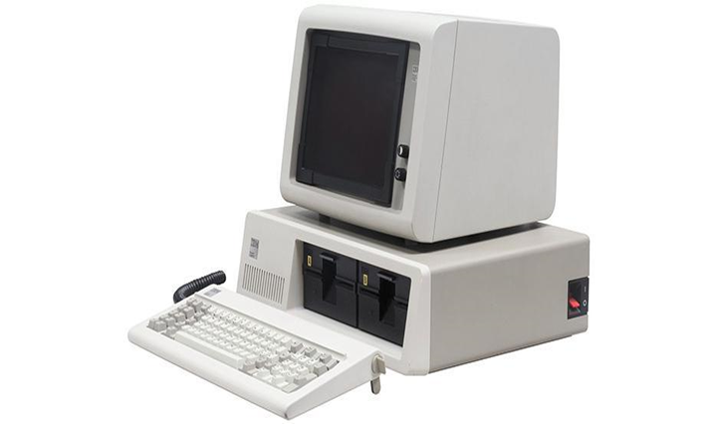
CRT (Cathode Ray Tube)
High energy electrons used to form a fluorescent screen.
Highly Reliable and efficient.
Resolution 2048 x 1536 pixels.
Affordable , Cost effective.

Slide 3
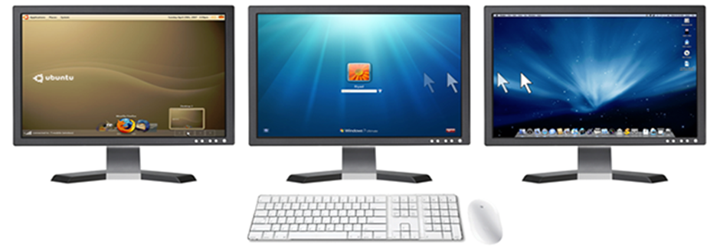
LCD (Liquid Crystal Display)
• Monochrome Pixels.
• Couple of transparent electrodes & two polarizing filters.
• Optical effect is achieved by polarizing the light in varied amounts and making it pass through the liquid crystal layer.
• Comes in 15-65 inch size.

Slide 4
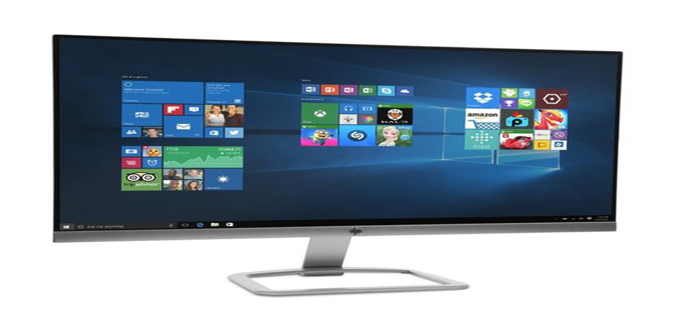
LED (Light-Emitting Diodes)
• Use emitting diodes at back for displaying anything on screen.
• You can watch the screen clear by viewing from any angle.
• LED has good contrast and is very close to natural view of picture.
• Comes in 17-70 inch size.

Slide 5
Monitor Connectors
• VGA (Video Graphics Array) .
• DVI (Digital Visual Interface) .
• HDMI (High Definition Multimedia Interface) .
• USB (Universal Serial Bus) .
• IDE (Integrated Drive Electronics) .
• SATA (Serial Advanced Technology Attachment).
• eSATA (External Serial Advanced Technology Attachment).
• Fire Wire.
• Ethernet.

Slide 6
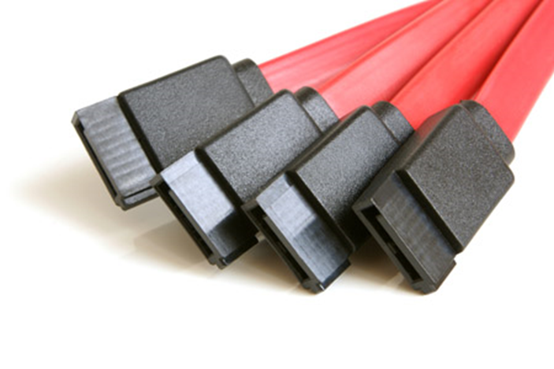
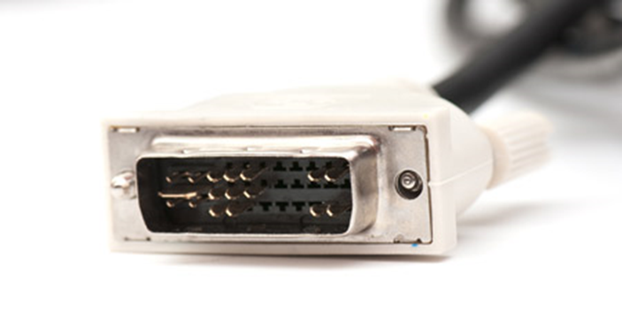
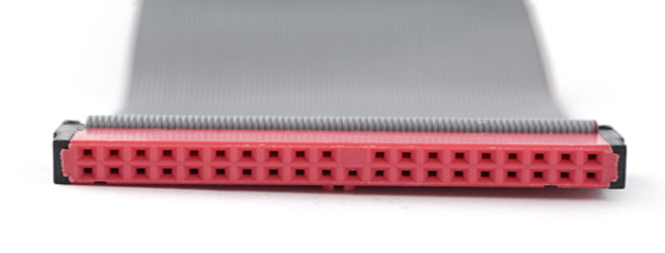
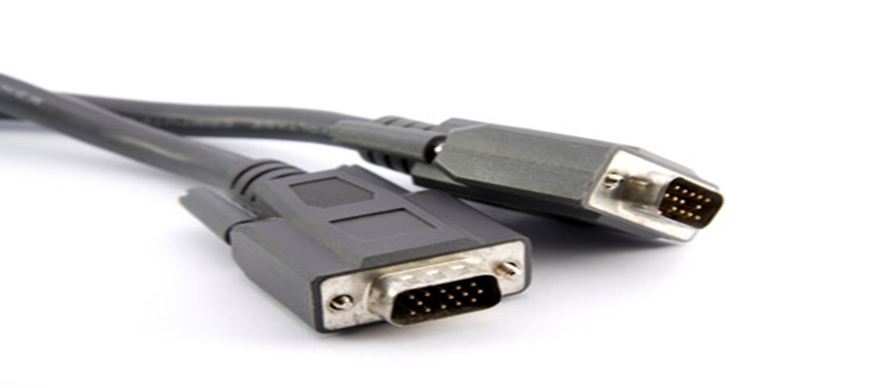
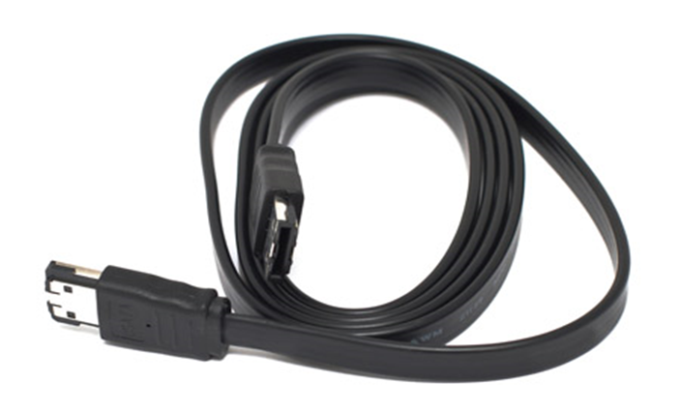
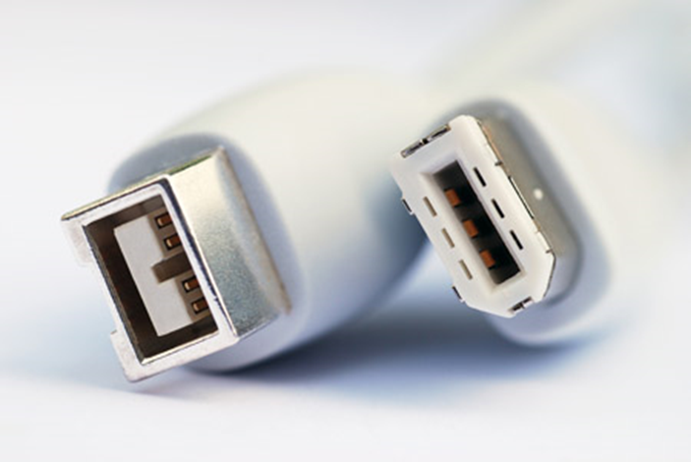
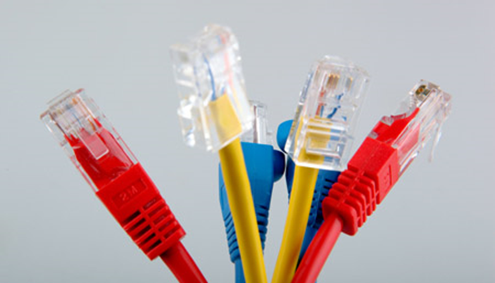
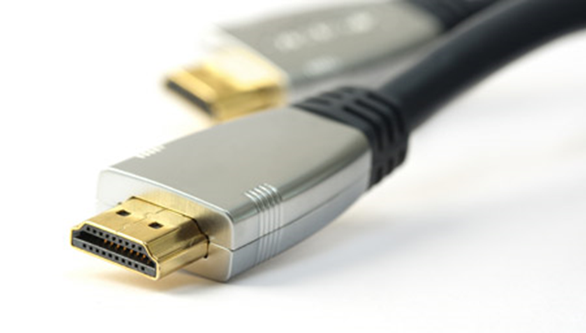
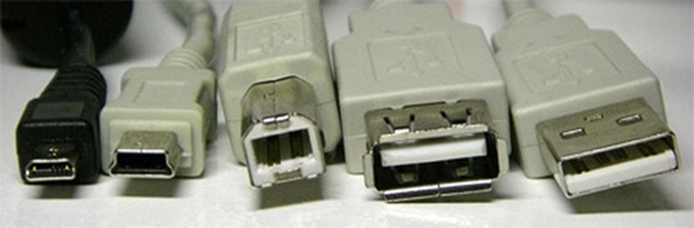
Monitor Connectors
VGA
DVI
IDE
SATA
eSATA
Fire Wire
Ethernet
HDMI
USB

